Slide 1

Super App Caremark, Specialty, Aetna Integration Roadmaps
Super App Think Tank Follow-up
March 2024

Slide 2
Summary
1
Plan for Single Account / Single Sign On
Current state:
Future plan:
Key dates:
Integrated functionality enabling Rx management across pharmacies (Retail, SRx, CMK)
2024: Separate SRx and CMK apps remain
Q2 2024, Planning to incorporate CMK and SRx onto homepage, enabling auto-pull of CMK dependents (minors) caregivee relationships using latest I90 services
Q3 2024, Onboarding: MVP onboarding experience will collect Retail, SRx, CMK as one consent to support integrated pharmacy experience. ability to see Aetna HSA/FSA balance and deductible on homescreen, allow patients to view their CMK / SRx-related prescriptions and deductible information on homescreen, connect CMK and SRx account info and add CMK dependents as caregivees in the super app, incorporate medication reminder functionality across LOBs
Q4 2024, View OTCHS balance on homescreen, enable 1 digital account creation flow across LOBs during onboarding
Future plan:
2025: CMK and SRx non-dispensing features (still refining), allowing users to log into CVS app with CMK and SRx credentials, Complete Aetna MLP
2026: Single app to integrate premium experiences across Caremark, Retail, and SRx. CMK and SRx have shared micro-app
Key dates:
Single integrated app: 2026
Sunsetting Caremark App: 2026? Unclear if there is formalized plan here, may require leadership alignment around what needs to be true in order to be able to sunset (e.g., transfer of data? Proactive user outreach?)
Sunsetting Specialty App: 2026? Same as CMK
2

Slide 3


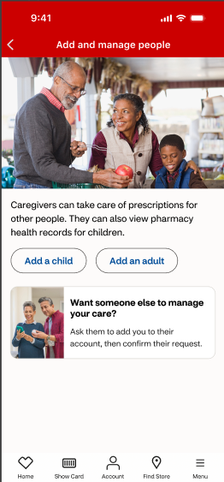
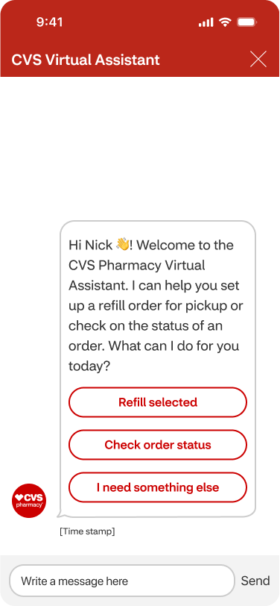
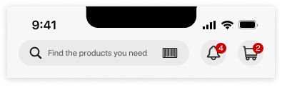
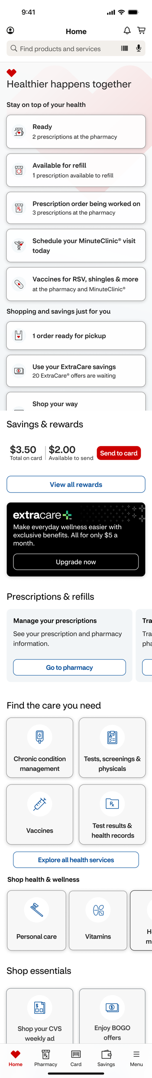



Super App Roadmap | MLP Update (1 of 2)
2
1. Homescreen
2. Caregiving
3. Health Triage
Delivered:
Optimize finding a minor/adult – Feb ‘24
New family management landing page – Feb ‘24
What’s up next:
Native caregiver enrollment & authorization – Q1
Recognize & surface potential caregivees – Q1
Allow multiple caregivers per caregivees – Q2
Delivered:
Launched navigation search widget for iOS & Android – Jan ‘24
What’s up next:
Native refill and order status experience via chat – Q2
Enhanced app navigation – Q2
Search view experience – Q2
Integrated drug, condition, and health service, search - Q2
4. Adoption & Engagement
5. Onboarding
Delivered:
Scaled new homescreen to 100% of iOS users and 25% of android users – March ‘24
What’s up next:
In process Rx scripts on HS – Q1
PHR reconsent to do list CTA – Q1
Caremark/Specialty Rx on HS – Q2
Launch NEW Personalized HS – Q2
Delivered:
BOPIS Order Status Push Message - Jan ‘24
Rx Transactional Push messages in iOS - scaled in Feb ‘24
What’s up next:
Rx Transactional Push messages in Android - end of March ‘24
Channel shift users from mWeb to App Tactics – Q2
Single messaging platform on Braze – Q2
Push Arbitration Layer MVP – Q2
Delivered:
Introduced existing email check – Feb ‘24
ExtraCare and biometric enrollment during account creation – Mar ‘24
What’s up next:
MVP onboarding flow – Q2
Keep Me Signed In – Q2
Health records lookup & tie – Q2

Slide 4
4Q Roadmap – Super App
Program | Q1 2024 | Q2 2024 | Q3 2024 | Q4 2024
App Home screen | Surface the ability for ICE users to see their Rx orders on reskin homescreen Elevate pharmacy Brilliant Basics with expanded order statuses to align with latest Retail Rx pharmacy dashboard (incl CMK and SP) To Do list enhancements to surface in-progress order statuses, promote PHR reconsent, and shop product shelves | Elevate pharmacy Brilliant Basics with cross LOB status tracker, ability to act on action notes and view store information (hours & address) Improved flexibility and speed of content delivery with implementation of CMS for the home screen experience Redesigned Super App Home screen goes live – A personalized home screen that shows relevant content and information based on the user's segment (single or multi-BU) Provide integrated calendar of scheduled activities to all users, across LOB (medication reminders, appointments etc) Users see recent, upcoming, and next available visit for Minute Clinic Launch apps map from home screen to easily navigate users to the store for Rx & Fs pick up Enable CMX placement on homepage for FS users | Users can view native health records and receive a notification when a new health record update or post visit summary/next step is available Launch a new integrated “Your health” dashboard Rx co-pay cost for FS and RX orders and easy access to Rx pricing Enable fast pick-up barcode for waiting bin Rx Aetna HSA/FSA balances/ deductibles are available on the home screen Caremark deductible information is available on the home screen Real-time, multi-step NBA decision engine is launched to support enterprise NBAs. Live-tracked refill status is available on phone lock screen Launch Oak Street entry point on homepage | Users can control views for self/family management/ caregiving "Store mode" overlay is available when customers are in-store. OTCHS balance with CTA to enter contextual catalog is surfaced
App Onboarding | Lay the foundation for Super app onboarding by launching a native 2 step sign in experience that leads with recognizing the user Migrate core onboarding flows to Super App UI: 2 step sign in, GAC, EAC, and forgot password Introduce ExtraCare sign up into the account creation experience Experience API integration for core access functionality Complete Rx-tie technology modernization for iOS Native caregiver enrollment, authorization, and removal flows | Launch initial onboarding driving authentication, prescription tie, ICE consent, and push opt-in Introduce health records lookup, tie, and consent during initial onboarding Introduce KMSI (keep me signed in) functionality Increase Rx tie success rate by integrating MNO and expanding phone numbers to OTP | Collect cross-LOB consent and HIPAA authorization Accept phone number as a valid username Introduce password-less login/sign up LOA2 account upgrades are streamlined based on cross LOB information Enable the ability to connect wearable devices Collect customer preferences and intentions to personalize the app experience Caregiving for Specialty and Caremark Super App user | Support the ability for 1 digital account creation flow across LOBs Consolidate all easy account creation flows into a unified flow Merge and connect retail accounts when detecting that a customer has multiple via a data conflict prompt Enable passkeys to work across app and web Auto detect and proactively prompt users to tie non-digital profiles to a digital account

Slide 5
4Q Roadmap – Super App
Program | Q1 2024 | Q2 2024 | Q3 2024 | Q4 2024
Caregiver Access | R: Improve our ID vetting through MNO services to replace ~90% of Lexus Nexus costs in Caregiving flows , as part of the Adult authorization process R: Allow non-CVS customers to become ID verified | R: Allow caregivees to have multiple caregivers R: Empower caregivees to initiate caregiver relationships C: Enable the auto-pull of CMK dependents (minors) caregivee relationships using latest I90 services R: Key notifications sent to Caregiver(r/e) post setup are streamlined | C: Enrich CMK experience to be similar to Retail for setting up Adult CG relationships (bidirectional invitation) S: Enable the auto pull of SP dependents (minors) caregivee relationships using latest I90 services R/C: Streamline notifications sent to Caregivee(r/e) post setup R: Allow non-CVS customers to become caregivers | Enterprise: Enable Caregivees to manage their caregiving relationships as a guest Enterprise: Launch advice on benefits and NBA during "moments that matter" via messaging and reminders during the CG journey Enterprise: Offer personalized caregiver support content available via NBA Enterprise: Empower the Caregive(r/e) to request changes to levels of access/permissions
Condition Onboarding & Rx Management | Begin building a centralized, scalable, comprehensive content repository and infrastructure to support enterprise digital health content Foundational backend work to support future Med reminder capability | Launch Medication Adherence and Condition Management dashboard Foundational backend work to support future Med reminder capability | Condition onboarding experience (pilot) is launched to educate patient on their condition and appropriate next steps (e.g., videos, articles, etc.) Launch capabilities to empower users to learn about their medications through self-service features (i.e. knowledge checks, how-to's) Medication reminder functionality is introduced for prescriptions from all LOBs on the customer’s existing medical profile as well as caregivees (leverages dose schedule information where available and app gestures) | Launch personalized condition experience based on user’s med profile Launch Medication reminders with associated positive reinforcement, including health rewards
Health Records | Design runway for native vaccine records Design runway for native lab results Prepare I90 APIs to power native experience (vaccine records) | Design runway for labs continued Native health dashboard with access to available health records (immunizations & lab results) – dark mode Prepare I90 APIs to power native experience (labs) | Native health dashboard with access to available health records (visits) – dark mode Prepare I90 APIs to power native experience continued (visit history) Begin integrations of health records with health landing page in native Updates to home screen / onboarding for Health records education/entry points | SMS/Email PDF download of health records in app Native access to health records go live (immunizations, labs, and visits) Send post-visit care reminders via push message Surface NBAs to recommend other services a customer could get in an already planned visit

Slide 6
4Q Roadmap – Super App
Program | Q1 2024 | Q2 2024 | Q3 2024 | Q4 2024
Health Triage | Conversational AI Allow SPL patients to upload their insurance card image within chat Enhance the IVR-VA experience by fixinf de-duping order submission, and move to I-90 app Launch new Calls in Queue to Chat Experience Order sub-status for Specialty pharmacy Search & Navigation Develop Configurable Home Screen Header to Enable Unified Header Across Pages Refresh the Bottom Tab Bar to Enhance Navigation Experience Enable voice search | Conversational AI Migrate Retail IOS and Android to Google Dialogflow and Nemo Build out performance scorecard for Retail App Launch SPL reschedule bot Launch EZRefill on SPL for 1 drug (Forteo) and expand to 3 additional therapies; add email and IVR channel support and ability to fill multiple drugs Fix key IVR-VA gaps by showing ineligible Rx Reasons, order substatuses, on-hold status and handling, and launching UX and design updates Store Retail and SPY App Chat within CVS cloud RTL: transfer and cancel intent Build Intent Managerand support NLU matchingfor order status Search & Navigation Enable LLM-based search backend that can route customers based on their search term across front store, drug, health/condition, and RX Expose Search View redesign to include quick links to popular BU functions, suggestions, and recent searches via I90 Design new foundational search app screen that integrates health services and drug experiences along-side products Continue implementing search redirects to simplify navigation for priority business search terms Refresh the home screen header to align with home screen and super app color scheme | Conversational AI Launch SPL Payment and Insurance Bot Expand EZRefill to all digitally fillable (5800 drugs) Expand Rx Action note support to include insurance reject, no response , and Prior Authorizations on all platforms NLU intents for order status, refill and other intents Search & Navigation See Rx and FS order status across LOBs Launch search results entry point into chat with context Handle appointment scheduling on SPL and RTL Enhancements to new enterprise search results page Advanced Null Search Results Handling Continue to make navigational design iterations informed by customer interaction and conversion data | Conversational AI Incorporate "Ask me anything" within Retail Virtual Assistant Appt Scheduling Answer, fulfill, and navigate core questions around pharmacy payments – all areas of Super App (Caregiver, account, onboarding, etc.) Additional bot automations: order promise time, caregiver set up, delivery Launch Search to chat Search & Navigation Scan RX bottle or product barcode to make RX actions or find a product Schedule, change, or cancel appoints within the Retail App Search by photo or pill Incorporate natural language/semantic search

Slide 7
4Q Roadmap – Super App
Program | Q1 2024 | Q2 2024 | Q3 2024 | Q4 2024
Health Rewards | Launch a home screen NBA for Rewards at the Pharmacy reconsent Push notifications for PHR rewards and promotion of PHR enrollment in various pharmacy flows | [RUNWAY] Reinforce PHR value through transactional messaging (refill, vaccines) | Incentivize digital behaviors (Fast pick up utilization) Explore scaling Healthy Rewards to EC & EC+ members | View integrated family rewards, reward history, and balances
Health Spending | [RUNWAY] Discovery of Savings & Balance Page and Cost & Coverage integrated component | User sees Rx co-pay cost for in-flight RX & FS orders on the homescreen [RUNWAY] Discovery to surface Aetna and NonCMK ID cards on block component Develop and launch integration of coupons/cash discount cards | Allow Aetna users to view their deductible information on the savings and balance page Allow Aetna users to view their HSA/FSA balance with access to eligible item catalog Create a centralized payment wallet that can be used across LOBs for EPP enabled cards Launch an integrated savings & balance page that will give users access to view their Caremark deductible and check drug cost | All OTCHS members to see their plan balance with access to a contextual catalog Notify user if the price changed for an autofill RX

Slide 8
4Q Roadmap – Super App
Program |  | Q1 2024 | Q2 2024 | Q3 2024 | Q4 2024
Adoption |  | Grow Push channel via improved opt-in experience for customers during onboarding flow and test & learn progressive push prompt Drive app adoption by adding smart app banners on cvs.com home and Rx home to encourage users to open or download the app | Enable HIPAA reconsent notifications to promote PHR Drive app adoption by implementing long-term web messaging solution with global header integration Drive users from mWeb to the App via S2C deep links in SMS & other EC Email use cases (Weekly Ad) Drive Monthyl Active Users via Reactivation Triggers Tests Drive new app downloads through in-store wifi captive portal Enable progressive onboarding Push and app messaging to drive profile completeness Drive new app downloads via App store search optimization | Drive personalization in messaging by implementing communication preferences Launch PHR adoption campaign | Enable new Push campaigns for to onboard new Caregivers via Caregiving MLP experience
Engagement | Brilliant Basics Transactional | Launch new Rx transaction campaigns by enabling Android for Real time Order Ready, Action Notes, Rx Received push campaign Launch BOPIS Push to help customers track their order | Drive self-service through enhanced Rx Action Notes experiences (long term out of stock), Rx Refill Reminder Migrate RxR transaction campaigns from Firebase to Braze Provide better customers tracking by enabling Same Day Delivery Push Enable push campaign to support Fast pick-up | Drive engagement for Health services flow by enable new push campaigns for upcoming MinuteClinic appointment scheduling Trigger Push Response to Retail Rx Voicemails Launch Auto refill reminder Push Drive volume from Rx SMS to Push by launching new campaigns: Video Counsel, Knowledge Check, Side Effect Outreach 90 Day, IMZ | Send post-visit care reminders and after visit summaries for Minute Clinic Appointments Bring push to par with SMS by launching Specialty and Caremark Order status push notifications Launch Specialty transactional Push campaigns for Order Received, Order Ready
Engagement: Premium Experience Engagement | Premium Experience Engagement | Shift user traffic from mWeb to app by creating deep links for current high volume Rx Transactional SMS and S2C Email campaigns | Shift user traffic from mWeb to app by creating deep links for Health Services high volume SMS and Email campaigns Enable newer capabilities to drive continuous engagement Live Activity tracking Action buttons for surveys Med adherence widget Educational model push campaign for search widget and natural language search Contextual push campaigns for gap in care program | Launch PHR adoption campaign Extend engagement by activating in-store mode through geolocation Rewarding health Rewards- Live Activity and Push campaign Health Spending- Proactive drug price awareness (educational modal) | Drive engagement to enterprise health services via Push/App messaging campaigns for Oak Street and Signify Health Extend engagement by activating in-store mode through geolocation Health Spending -Checkout and payment enhancement awareness via educational modals
Messaging Platform Modernization |  | Create single messaging platform by migrating Rx campaigns from Firebase over to Braze platform Update Braze Custom Attributes & Events to Enable New Campaigns Orchestration Layer Design Purchase Tracking for Mobile Messaging Common Destination Routing & Adapters | Implementation of Push/NBA Orchestration layer to govern coordinated delivery of Push & in-app NBA content to customers Improve analytics for Braze campaigns bypassing CMT campaign ID from currents over to Snowflake Enhancing campaign creation using Adobe tools Common Destination Routing Adapters: Account + Health | Drive campaign efficiency via self-serve messaging platform in Braze

Slide 9
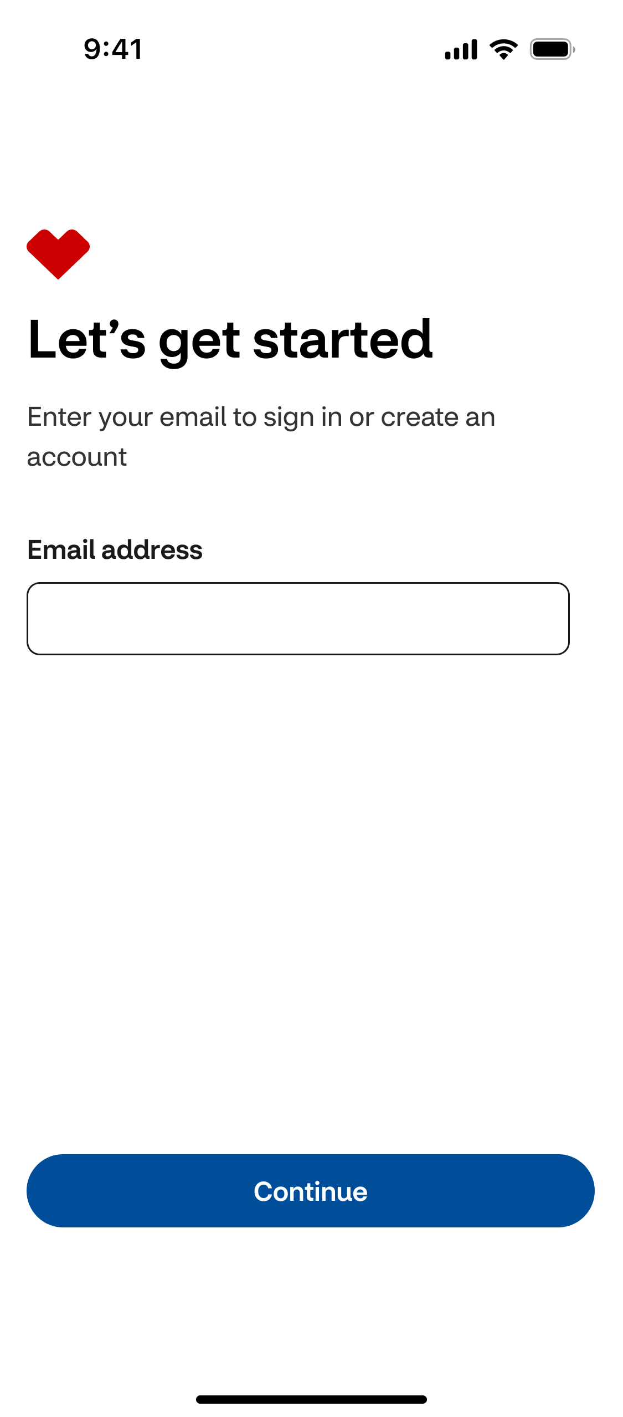
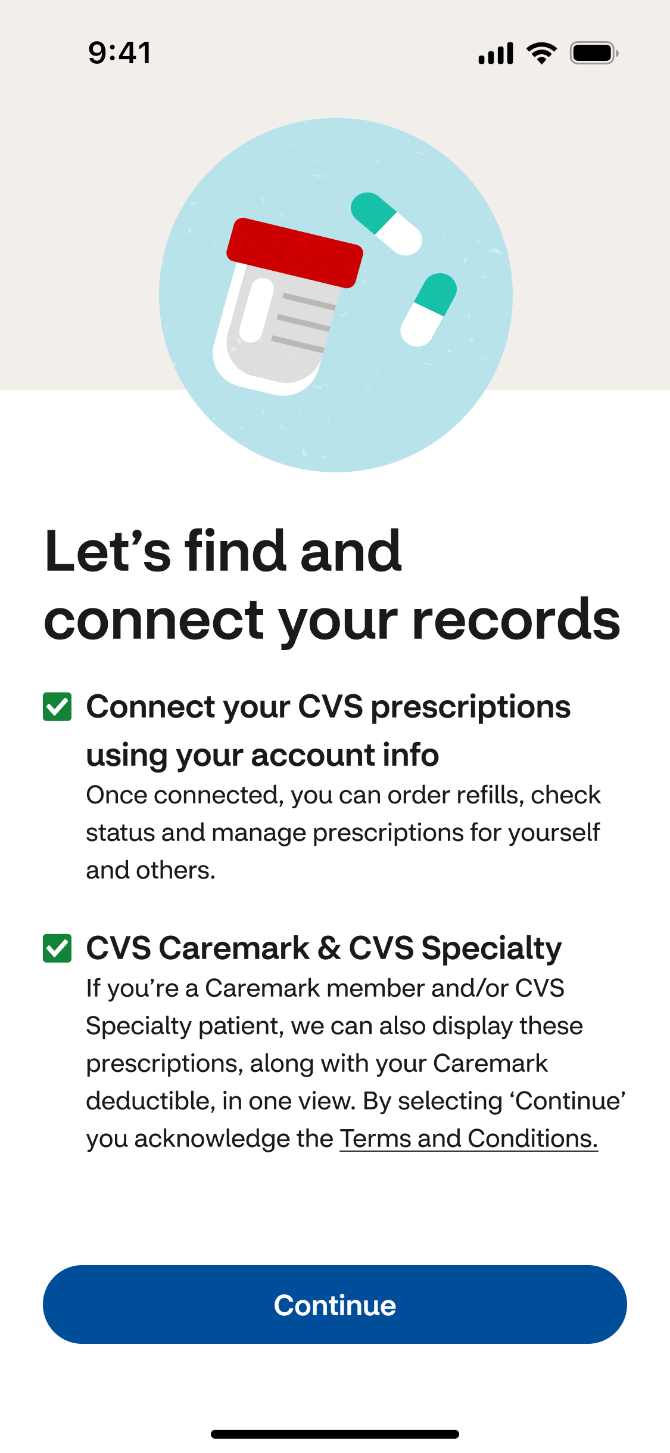
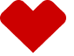
App onboarding | Our approach reflects best-in-class practices and significantly reduces steps to access an integrated experience
2
MVP experience launching in Q2 2024
Enhance the customer’s first interaction with the CVS app by introducing an onboarding experience to drive new user engagement.
Welcome customers into the CVS app
Driving recognition via sign in and account creation
Streamline Pharmacy (cross LOB) and Loyalty onboarding to drive a first visit engagement
Look up and connect prescriptions using minimal PII
Collect Retail + Specialty + Caremark as one consent to support an integrated pharmacy experience
Link or enroll users in ExtraCare
Drive push opt-in to increase repeat engagement
1
2
3
Welcome animation
Leads with recognition
RX tie look up and ICE consent
4
56% reduction in steps to onboard into a new digital account with prescriptions and an ExtraCare card connected

Slide 10
Super App Onboarding (1/2)
Teams | Rank | Feature | Description | Dep | GTM
Initial Onboarding & Access | 1 | App download onboarding MVP (complete effort started in PI1) | Drive first visit engagement and retention via recognition, enrichment, consent, and push opt-in. | Mainframe issues | May
 | 2 | Keep me signed in (complete effort started in PI1) | Improve stability and make it easier for customers to continuously access functionality behind login. | Core access + cross-train testing | May
 | 3 | Look up email in Retail (related to I90) | Prepare for one account construct by migrating to API which references account IDP. | Core Access | Q2
 | 4 | Reduce friction during RX tie by integrating MNO to reduce Lexus Nexus dependency | Implement a mobile network operator (MNO) check that will verify the information provided by the user in their profile matches what the MNO provider has on file during RX tie. | Account Enrichment | Q2
 | 5 | Reusabe OTP for EC enrollment and Health Services | Improve security and mitigate fraud by creating reusable OTP experience which will be integrated into onboarding, EC enrollment, and health service scheduling flows. | Core Access, Loyalty, Scheduling | Q3
 | 6 | Expand user state and consent tracking for OKRs | Introduce attributes to track and target based on MRN state, ICE consent state, and HD consent. |  | Q2
 | 7 | Experian email check during account creation | Mitigate fraud by validating email addresses during account creation. | Core Access | Q2
 | 8 | Change in integration of biometric to account for xLOB | Improve security and prepare for one account construct by migrating to new biometrics authentication. | Core Access | Q2
 | TBD | Collect location opt-ins during onboarding | Prompt to enable location services during new app download onboarding by reinforcing benefits. | Adoption and Engagement | Q2
 |  | Enabler: Phone number as a username | Design and technology enabler to prepare for one account construct by defining the experience and solution supporting phone number as a username and accounts working as password-less. | Core Access | Q3
 |  | Enabler: Collect xLOB consent & HIPPA Authorization | Design and technology enabler to collect cross-LOB consent from new and existing users. | Account Management | Q3
 |  | Enabler: Digital accounts function purely as password-free | Design and technology enabler to make all accounts work as password-less. | Core Access | Q3
Presenter: Chris Jones
Notes:
To check with Jess on whether in scope for PI2:
Experience APIs for native apps for CMK patients
Unhappy path for progressive profile (alternate methods to lookup cross-LOB profiles such as diff PII, Rx bottle scan)
Passwordless create account + login
Introduce KMSI functionality
Integrating MNO and expanding phone numbers to OTP

Slide 11
Super App Onboarding (2/2)
Teams | Rank | Feature | Description | Dep | GTM
Progressive Onboarding & Enrichment | 1 | Consolidated progressive profile look up and tie flow for prescriptions and health records | Make it easy for existing users to look up and tie prescriptions and health records by expanding initial onboarding flow as a base and support unhappy paths. | Core Access, Account Management | Q2
 | 2 | Allow multiple caregivee/caregiver relationships | Remove one-to-one relationship construct and allow a patient to have multiple caregivers. | Account Enrichment
 | 3 | Allow a caregivee to invite a caregiver | Optimize caregiving experience by allowing a patient to request someone as a caregiver. | Account Enrichment
 | 4 | Implement experience APIs for RX tie | Technology modernization effort to integrate modern APIs supporting RX tie events.
 | 5 | Enabler: Prompt for Caremark dependents | Prompt users to add patients as caregivees based on Caremark plan dependents. | Account Enrichment, Home Screen, A&E | Q3
 |  | Enabler: Identify verification with RX tie | Prompt users to upgrade to LOA2 without requiring prescription or health records tie. | Account Enrichment
Presenter: Chris Jones

Slide 12


High level integrated roadmap for Super Apps
2
CVS built micro-app inside Aetna Super App
Aetna built micro-app inside CVS Super App
2024 (commitments)
2025 (planned, need to finalize capacity)
CVS Super App
New visual design, including White Label capabilities
Brilliant Basics/ETMMs²
Personalized Home Screen
Enhanced onboarding including Multi-BU consent
Push notifications expansion
MLP premium engagement features
Caregiving^{1,2}
Condition management^{1,2}
Health Records²
Health Triage, including Chat
Health Rewards²
Health Spending (including balances from Aetna/partners)
Continued expanded scope on MLP premium engagement features
Caremark features (non-dispensing; shared micro-app in 2026)
Specialty features (non-dispensing; shared micro-app in 2026)
White label instance of the app
Shared micro-apps
CVS Rx Management (across all 3 pharmacies + associated caregiving management)
CVS Appointment Scheduling (Rx, MC)
Aetna Spending Summary (Medical/Dental)
Profile/preferences
Centralized health records
Health Triage
Condition / medication management
OTCHS balance + link to catalog
Find Care/ Provider Search
Conversational AI Cx
Aetna Super App
Brilliant Basics/ETMMs
Elevated experience design (UX/UI)
App experience in Spanish (multilingual offering)
Commercial gaps closures
Personalized home screen and health journeys
Improved search
Conversational AI chatbot
Smart provider search
Health & Wellness integrations
Employer configurations
MLP premium engagement features
Enhanced provider search with integrated transparency
Behavioral Health access to care (provider search, programs)
Health Triage (focus on benefits and programs)
Health Spending Insights
¹ Some MLP functionality still pending capital discussions.
² Commitments with significant backend system dependencies

Slide 13
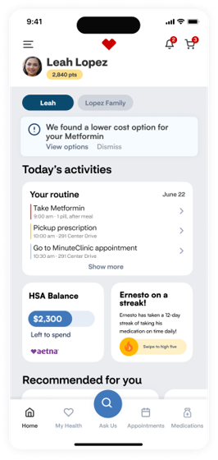
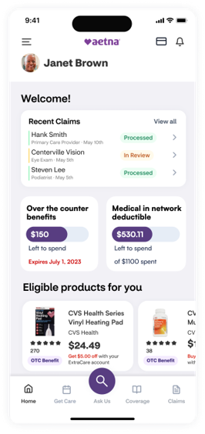
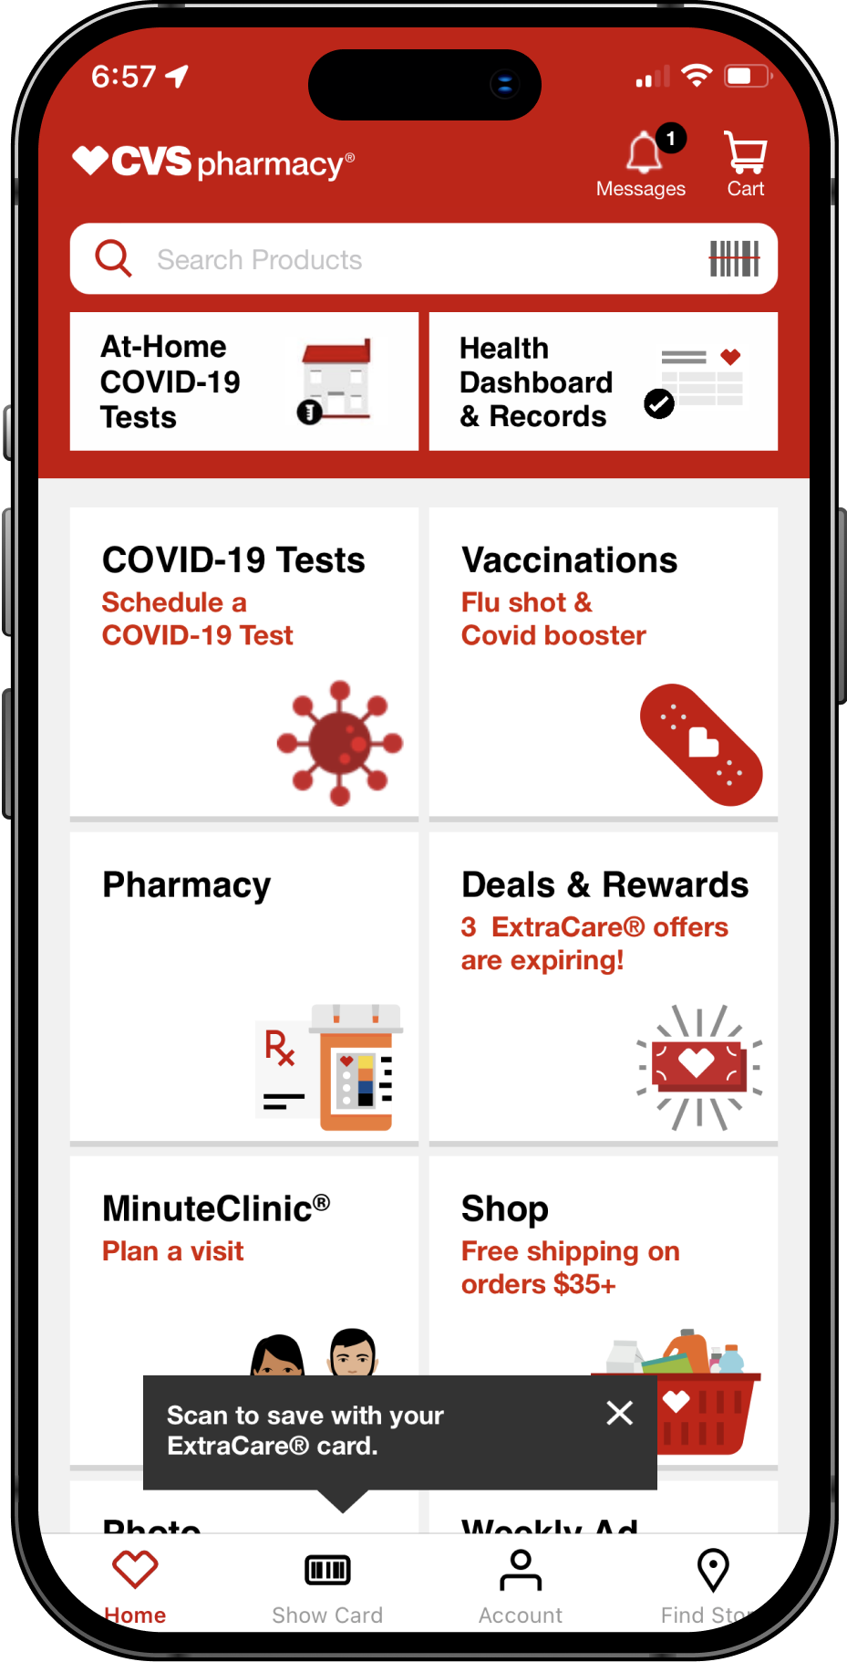
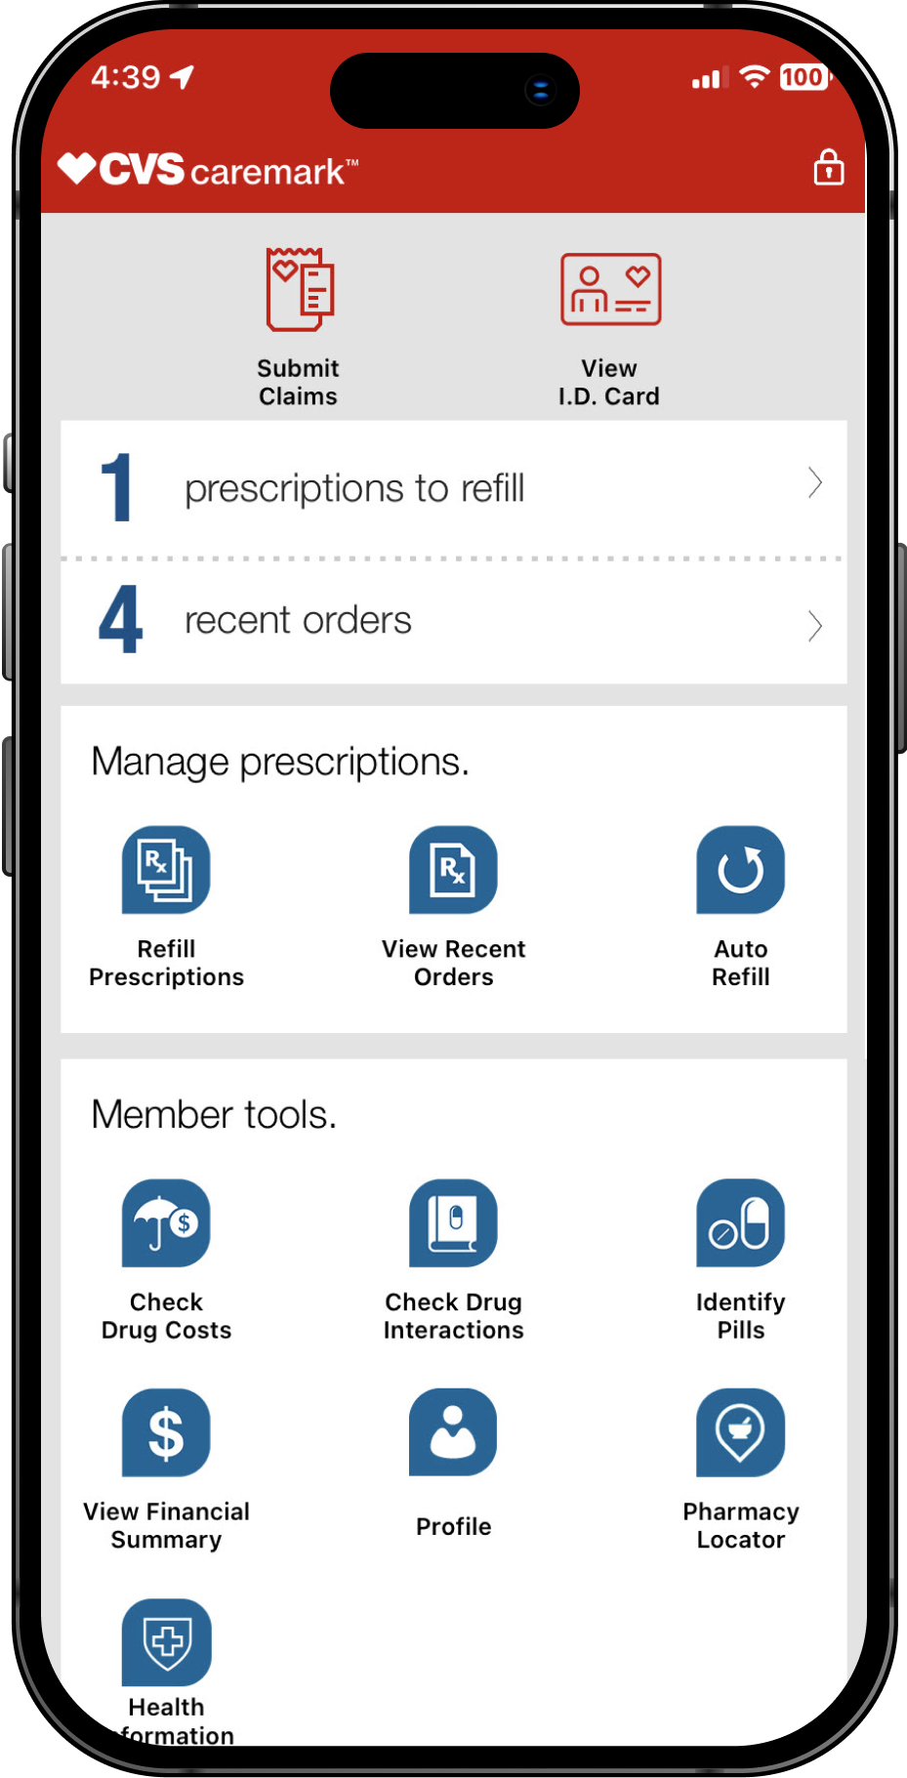
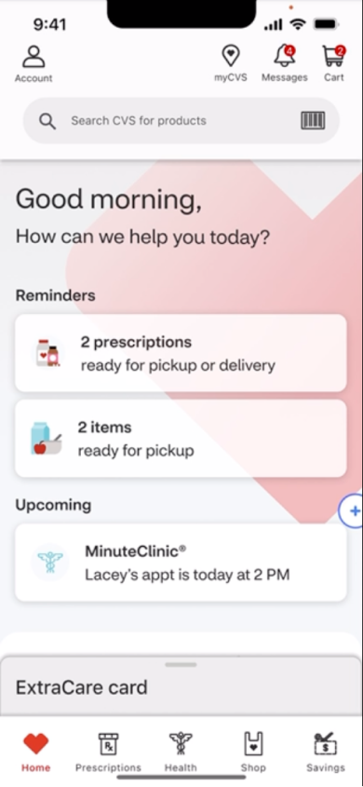
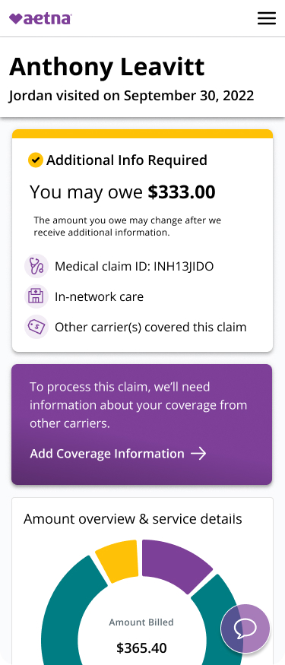
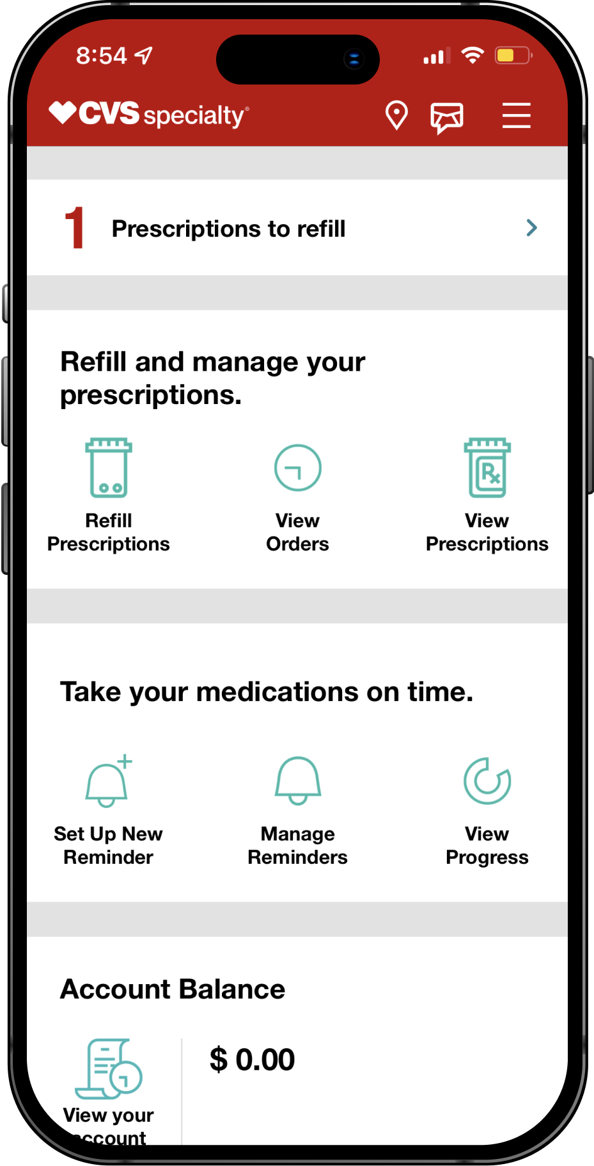
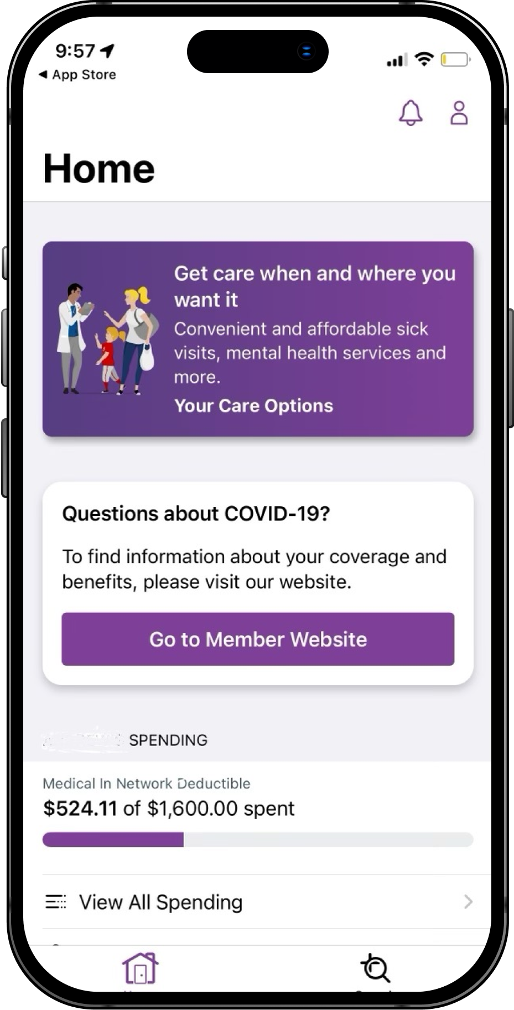
The evolution of our Super Apps is underway with new Minimum Lovable Product (MLP) features being released over the coming quarters
2
2022
2023
2024
2025
2026
CVS and Aetna current apps (i.e., Caremark, Specialty, Pharmacy etc.)
Brilliant Basics and core foundational improvements on the CVS Health app and Aetna web/mobile web
New visual design and CVS Health MLP features integrated
Complete the Aetna MLP. CVS Health premium experiences
Aetna premium experiences + CVS Super App enables user to experience all of CVS Health enterprise in one place

Slide 14
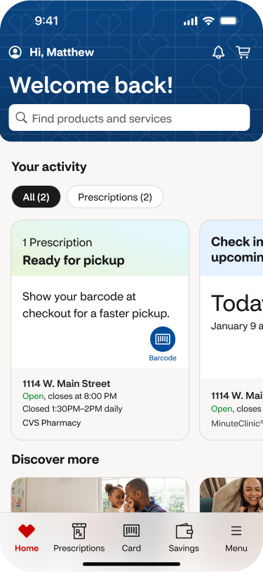
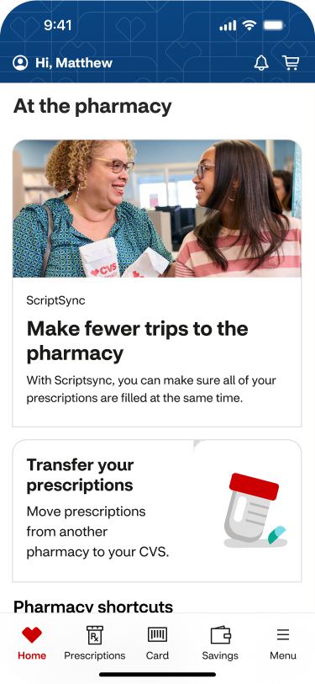
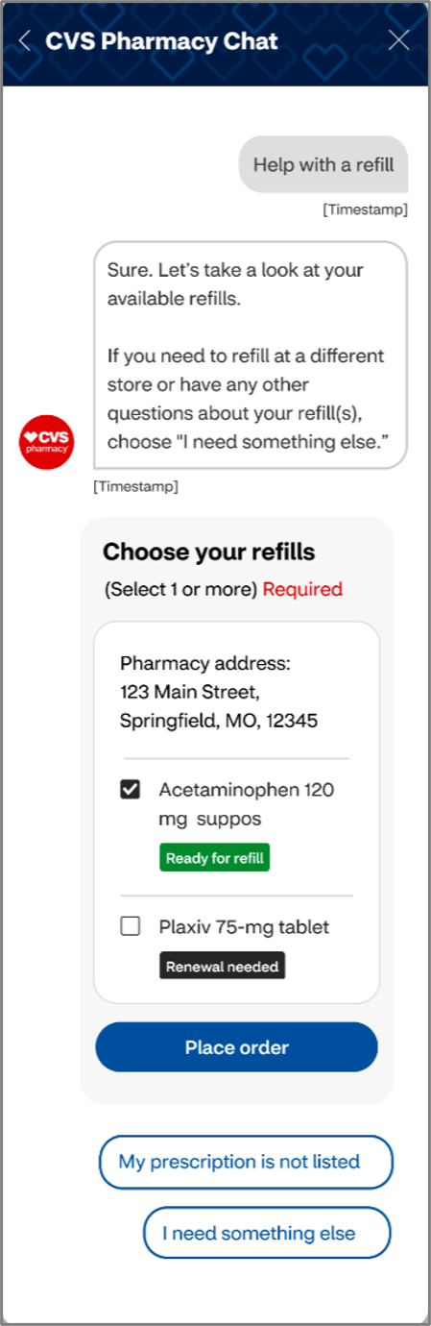
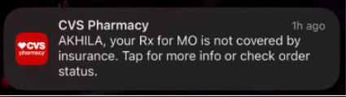
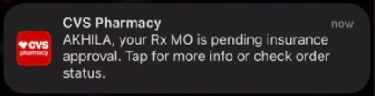
CVS Super App Future State Capabilities
2
Connect records across CVS, Caremark, and Specialty
View & take action on Rx order status right from the homescreen
Manage prescriptions across CVS, Caremark, and Specialty for yourself + your family
Integrated pharmacy chat provides assistance for refilling prescriptions, FAQs, etc.
Receive push notifications for Rx action notes such as Prior Auth status
Note: Visuals above are meant to provide a high-level overview of the app’s future state capabilities. Actual designs may vary.

